Slide 1
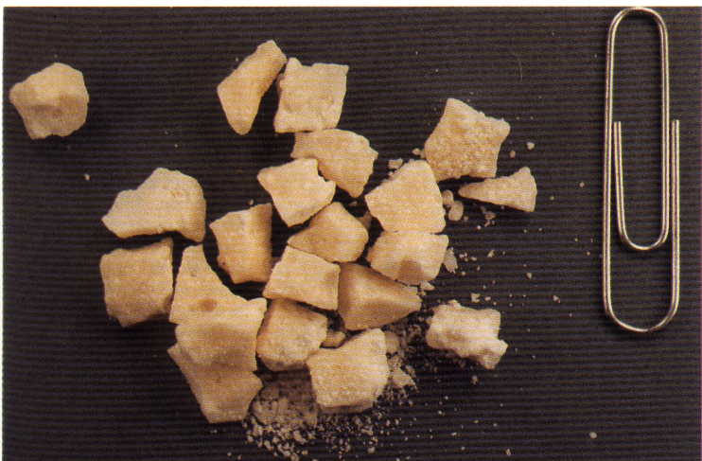
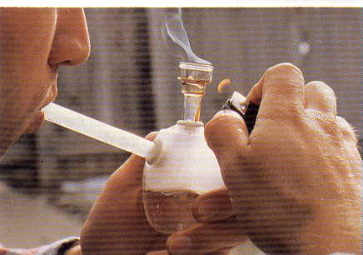



Mid-Course Review
Drugs,
Drug Categories,
and the Drug Influence
Evaluation

Slide 2
Drugs, Drug Categories, and the Drug Influence Evaluation
Define the word “drug”
Name the seven drug categories
Name the four subcategories of CNS Depressants
Name the three subcategories of CNS Stimulants
Name the two sub-categories of Narcotic Analgesics

Slide 3
Identify the Drug Category for:
Desoxyn
Secobarbital
Fentanyl
Alprazolam
Phenyl Cyclohexyl Piperidine
“Ecstasy”
ETOH
Demerol
Psilocybin

Slide 4
12 Components of the Drug Influence Evaluation

Slide 5
Demonstrations
Preliminary Examination
Eye Examinations
Administration of the Divided Attention Tests
Vital Signs Examinations
Darkroom Examinations
Check for Muscle Tone and the Inspection for Injection Sites

Slide 6
Identify the Drug Category for:
Morphine
Adderall
Chlordiazepoxide
Ketamine
Oxycodone
Ritalin
Bufotenine
Methaqualone

Slide 7
Eyes and Vital Signs Review
Horizontal Gaze Nystagmus (HGN)

Slide 8
Eyes and Vital Signs Review
Vertical Gaze Nystagmus (VGN)

Slide 9
Eyes and Vital Signs Review
Pupil Size and Rebound Dilation
Name the lighting conditions under which we make estimations of pupil size
Name the other things a DRE looks for while shining the light directly into the subject’s eye

Slide 10
Eyes and Vital Signs Review
Pupil Size and Rebound Dilation
How quickly must the pupil start to constrict if it is considered to exhibit normal reaction to light?
Define Rebound Dilation
State the DRE average ranges of pupil size for the three lighting conditions

Slide 11
What Do These Terms Mean?
Miosis
Mydriasis
Ptosis

Slide 12
Pupil Dilation and Constriction
What categories of drugs cause dilation of the pupils?
What categories of drugs cause constriction?

Slide 13
More Drugs to Categorize
Oxycodone
Halcion
Gabapentin
Peyote
Ritalin
Diazepam
Dexedrine
Codeine
Lorazepam

Slide 14
Circulatory System Review
Define “Pulse”
Define “Pulse Rate”
Define “Artery”
Define “Vein”

Slide 15
Where Are These Pulse Points Located?
Radial
Brachial
Carotid

Slide 16
Pulse Point Location
What is the normal range of adult pulse rate?
Name the drug categories that usually cause elevated pulse rate.
Name the drug categories that usually cause lowered pulse rate.

Slide 17
Blood Pressure Review
Define “Blood Pressure”
How often does a person’s blood pressure change?
When does the blood pressure reach its highest value?
When does the blood pressure reach its lowest value?

Slide 18
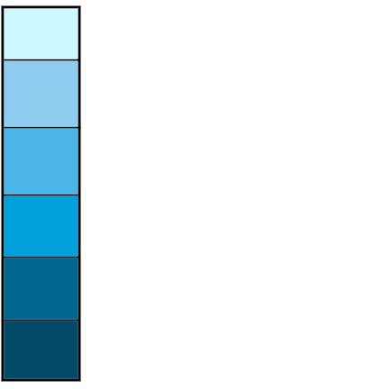
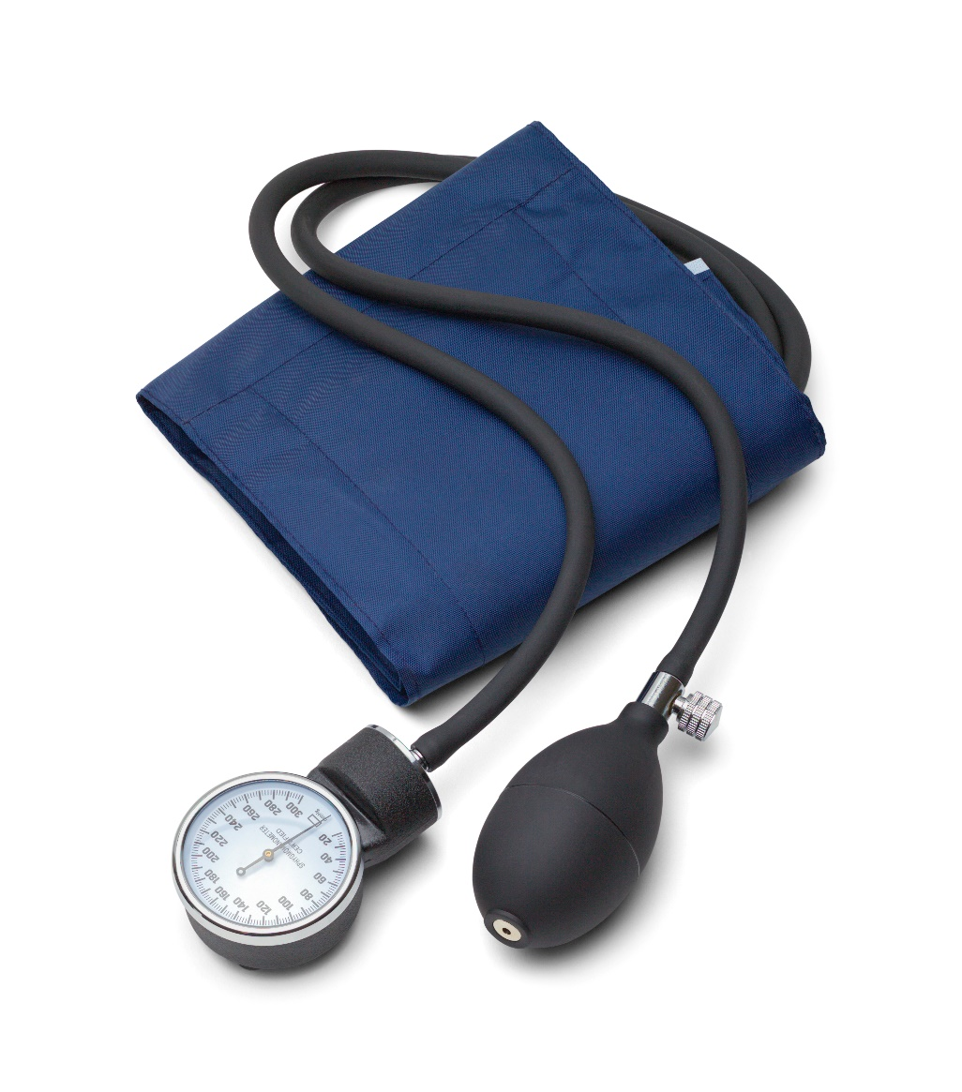
Blood Pressure Review
130~~
120~~
110~~
100~~
90~~
80~~
70~~
60~~

Slide 19
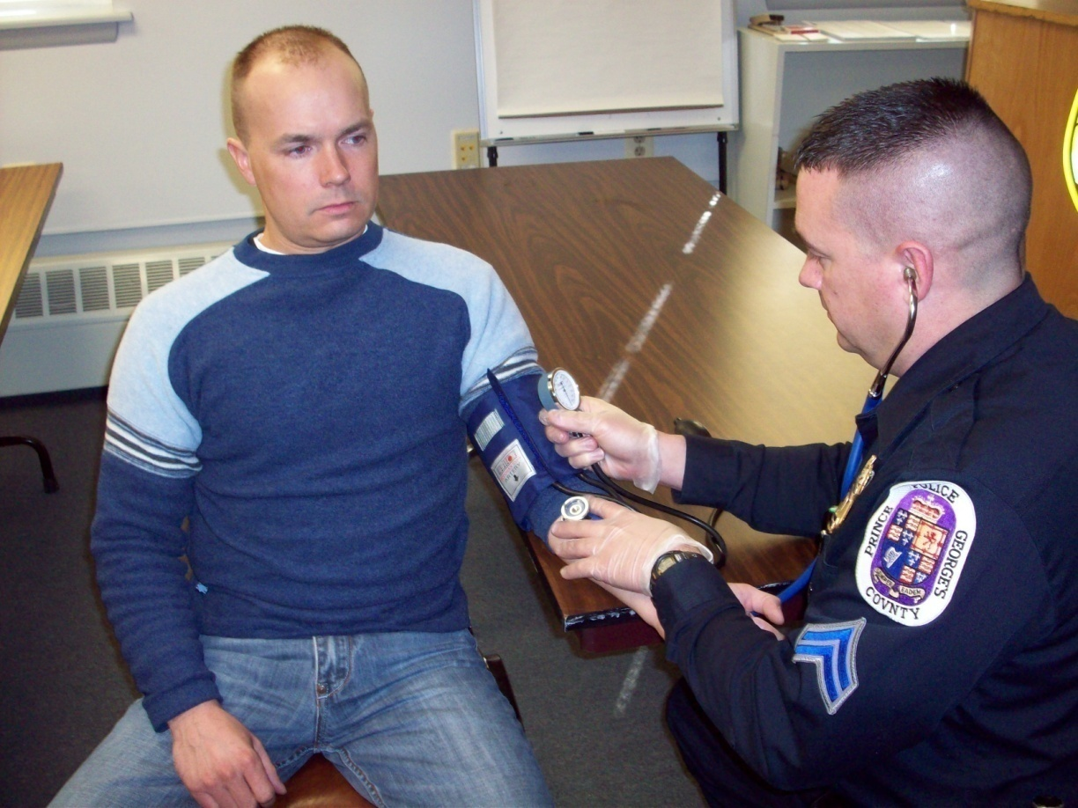
Blood Pressure Review

Slide 20
Drugs and Blood Pressure
Name the drug categories that usually cause a lowered blood pressure
Name the drug categories that elevate blood pressure

Slide 21
Some Technical Terms to Define
Systolic
Diastolic
Bradycardia
Tachycardia
Hypertension
Hypotension

Slide 22
Blood Pressure Measurement
State the normal range of systolic blood pressure.
State the normal range of diastolic blood pressure.

Slide 23
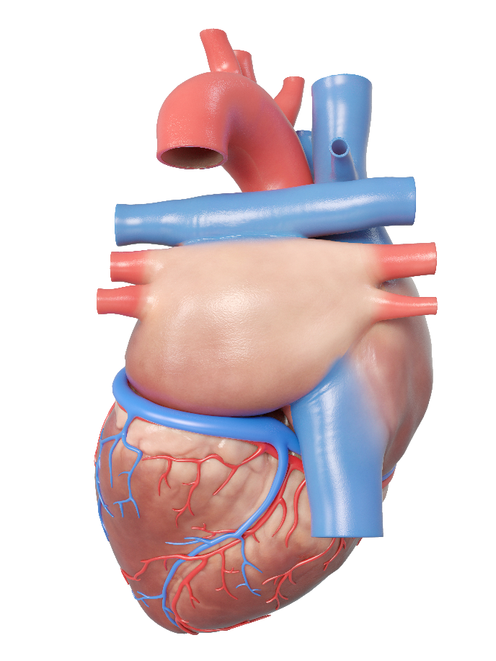
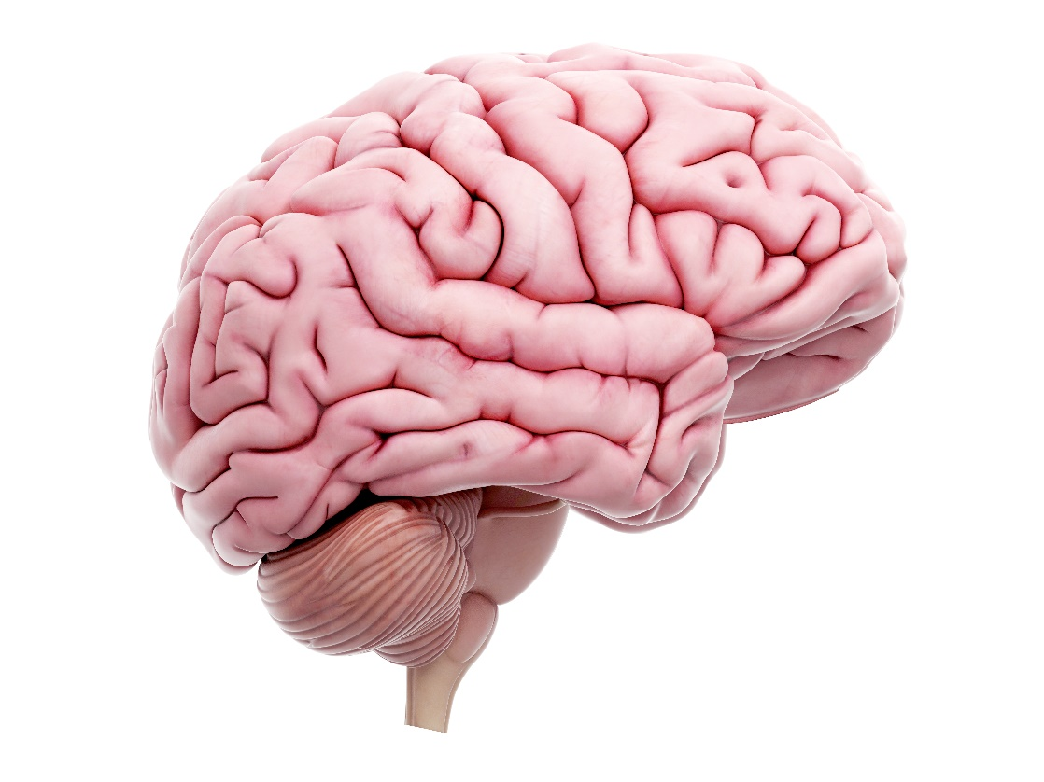
Physiology Review

Slide 24
MURDERS INC.

Slide 25
Physiology Review

Slide 26
Classification of Nerves
All Nerves
Sensory
Motor Nerves
Autonomic
Voluntary
Sympathetic
Parasympathetic

Slide 27
More Technical Terms to Define
Neuron
Synapse
Neurotransmitter
Axon
Dendrite

Slide 28
Questions?

